Slide 1
Chap 3: Fuzzy Rules and Fuzzy Reasoning
Fuzzy Rules and Fuzzy Reasoning
J.-S. Roger Jang (張智星)
CS Dept., Tsing Hua Univ., Taiwan
http://www.cs.nthu.edu.tw/~jang
jang@cs.nthu.edu.tw
Notes:
...
In this talk, we are going to apply two neural network controller design techniques to fuzzy controllers, and construct the so-called on-line adaptive neuro-fuzzy controllers for nonlinear control systems. We are going to use MATLAB, SIMULINK and Handle Graphics to demonstrate the concept. So you can also get a preview of some of the features of the Fuzzy Logic Toolbox, or FLT, version 2.

Slide 2
Outline
Extension principle
Fuzzy relations
Fuzzy if-then rules
Compositional rule of inference
Fuzzy reasoning
Notes:
Specifically, this is the outline of the talk. Wel start from the basics, introduce the concepts of fuzzy sets and membership functions. By using fuzzy sets, we can formulate fuzzy if-then rules, which are commonly used in our daily expressions. We can use a collection of fuzzy rules to describe a system behavior; this forms the fuzzy inference system, or fuzzy controller if used in control systems. In particular, we can can apply neural networks?learning method in a fuzzy inference system. A fuzzy inference system with learning capability is called ANFIS, stands for adaptive neuro-fuzzy inference system. Actually, ANFIS is already available in the current version of FLT, but it has certain restrictions. We are going to remove some of these restrictions in the next version of FLT. Most of all, we are going to have an on-line ANFIS block for SIMULINK; this block has on-line learning capability and it ideal for on-line adaptive neuro-fuzzy control applications. We will use this block in our demos; one is inverse learning and the other is feedback linearization.

Slide 3
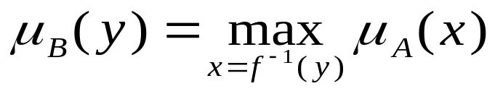
Extension Principle
A is a fuzzy set on X :
The image of A under f( ) is a fuzzy set B:
where yi = f(xi), i = 1 to n.
If f( ) is a many-to-one mapping, then
Notes:
A fuzzy set is a set with fuzzy boundary. Suppose that A is the set of tall people. In a conventional set, or crisp set, an element is either belong to not belong to a set; there nothing in between. Therefore to define a crisp set A, we need to find a number, say, 5??, such that for a person taller than this number, he or she is in the set of tall people. For a fuzzy version of set A, we allow the degree of belonging to vary between 0 and 1. Therefore for a person with height 5??, we can say that he or she is tall to the degree of 0.5. And for a 6-foot-high person, he or she is tall to the degree of .9. So everything is a matter of degree in fuzzy sets. If we plot the degree of belonging w.r.t. heights, the curve is called a membership function. Because of its smooth transition, a fuzzy set is a better representation of our mental model of all? Moreover, if a fuzzy set has a step-function-like membership function, it reduces to the common crisp set.

Slide 4
Fuzzy Relations
A fuzzy relation R is a 2D MF:
Examples:
  x is close to y (x and y are numbers)
  x depends on y (x and y are events)
  x and y look alike (x, and y are persons or objects)
  If x is large, then y is small (x is an observed reading and Y is a corresponding action)
Notes:
Here I like to emphasize some important properties of membership functions. First of all, it subjective measure; my membership function of all?is likely to be different from yours. Also it context sensitive. For example, I 5?1? and I considered pretty tall in Taiwan. But in the States, I only considered medium build, so may be only tall to the degree of .5. But if I an NBA player, Il be considered pretty short, cannot even do a slam dunk! So as you can see here, we have three different MFs for all?in different contexts. Although they are different, they do share some common characteristics --- for one thing, they are all monotonically increasing from 0 to 1. Because the membership function represents a subjective measure, it not probability function at all.

Slide 5
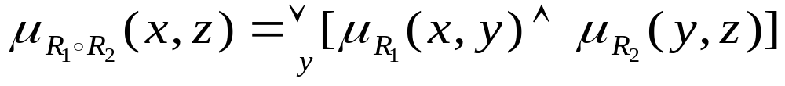

Max-Min Composition
The max-min composition of two fuzzy relations R1 (defined on X and Y) and R2 (defined on Y and Z) is
Properties:
  Associativity:
  Distributivity over union:
  Week distributivity over intersection:
  Monotonicity:

Slide 6
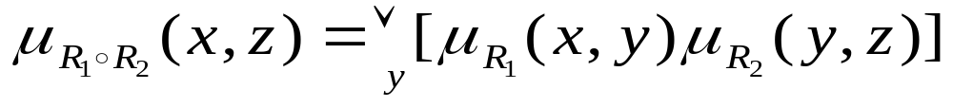
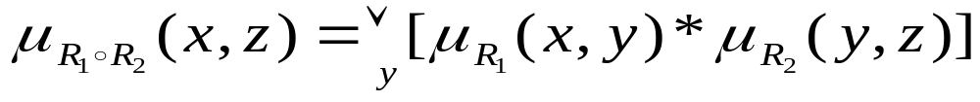
Max-Star Composition
Max-product composition:
In general, we have max-* composition:
where * is a T-norm operator.

Slide 7
Linguistic Variables
A numerical variables takes numerical values:
Age = 65
A linguistic variables takes linguistic values:
Age is old
A linguistic values is a fuzzy set.
All linguistic values form a term set:
  T(age) = {young, not young, very young, ...
  middle aged, not middle aged, ...
  old, not old, very old, more or less old, ...
  not very yound and not very old, ...}

Slide 8
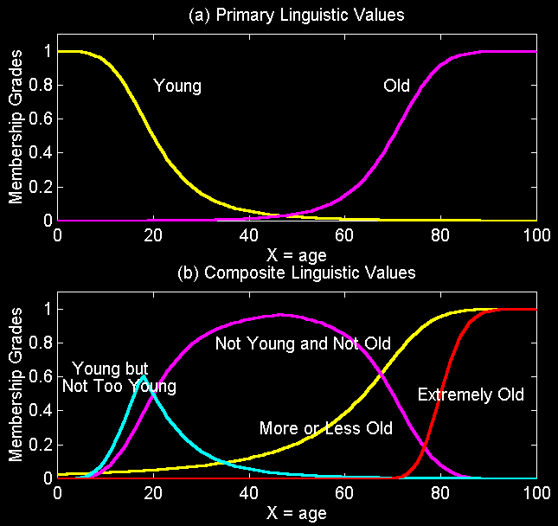
Linguistic Values (Terms)
complv.m

Slide 9

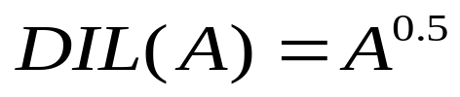
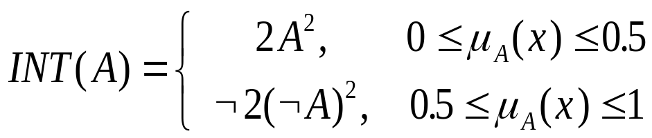
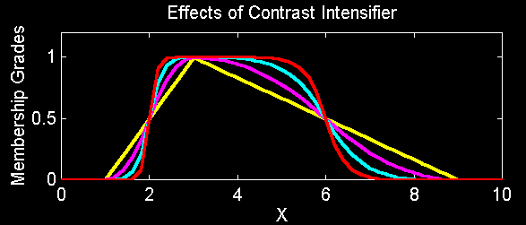
Operations on Linguistic Values
Concentration:
Dilation:
Contrast
intensification:
intensif.m

Slide 10
Fuzzy If-Then Rules
General format:
  If x is A then y is B
Examples:
  If pressure is high, then volume is small.
  If the road is slippery, then driving is dangerous.
  If a tomato is red, then it is ripe.
  If the speed is high, then apply the brake a little.

Slide 11
Fuzzy If-Then Rules
Two ways to interpret “If x is A then y is B”:
A coupled with B
A entails B
y
y
B
B
x
x
A
A

Slide 12
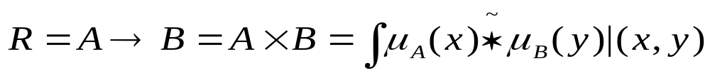
Fuzzy If-Then Rules
Two ways to interpret “If x is A then y is B”:
  A coupled with B: (A and B)
  A entails B: (not A or B)
    Material implication
    Propositional calculus
    Extended propositional calculus
    Generalization of modus ponens

Slide 13
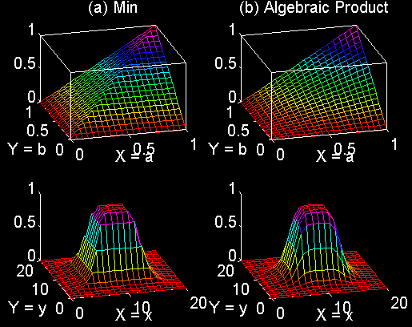
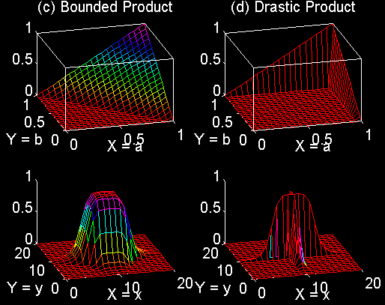
Fuzzy If-Then Rules
Fuzzy implication function:
A coupled with B
fuzimp.m

Slide 14
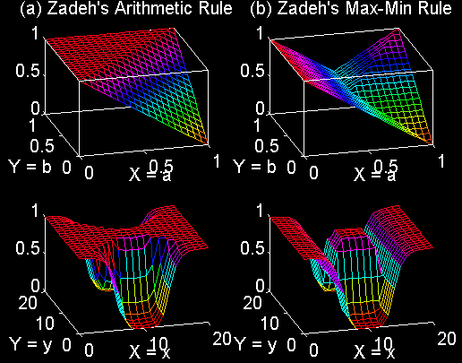
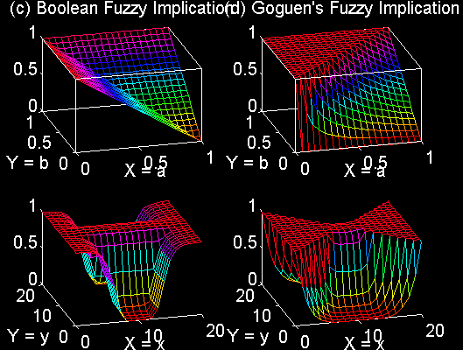
Fuzzy If-Then Rules
A entails B
fuzimp.m

Slide 15
Compositional Rule of Inference
Derivation of y = b from x = a and y = f(x):
y
y
b
b
y = f(x)
y = f(x)
a
x
x
a
a and b: points
y = f(x) : a curve
a and b: intervals
y = f(x) : an interval-valued
function

Slide 16
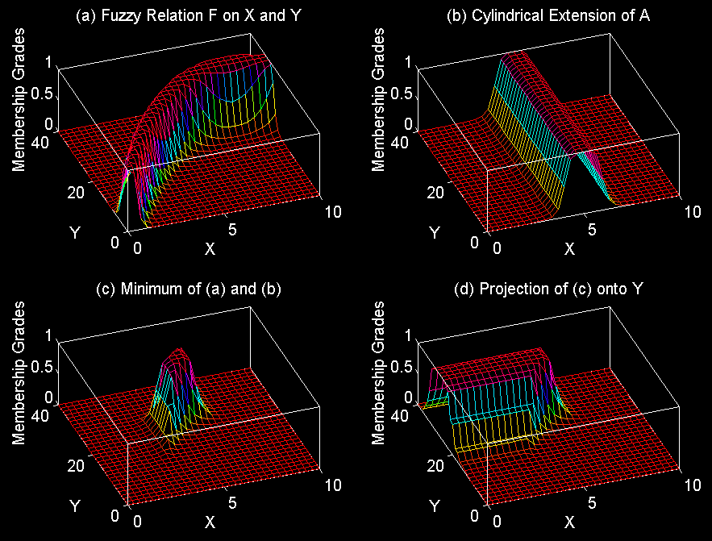
Compositional Rule of Inference
a is a fuzzy set and y = f(x) is a fuzzy relation:
cri.m

Slide 17
Fuzzy Reasoning
Single rule with single antecedent
  Rule: if x is A then y is B
  Fact: x is A’
  Conclusion: y is B’
Graphic Representation:
A’
A
B
w
X
Y
A’
B’
X
Y
x is A’
y is B’

Slide 18
Fuzzy Reasoning
Single rule with multiple antecedent
  Rule: if x is A and y is B then z is C
  Fact: x is A’ and y is B’
  Conclusion: z is C’
Graphic Representation:
A’
A
B’
B
T-norm
C2
w
Z
X
Y
A’
B’
C’
Z
x is A’
X
y is B’
Y
z is C’

Slide 19
Fuzzy Reasoning
Multiple rules with multiple antecedent
  Rule 1: if x is A1 and y is B1 then z is C1
  Rule 2: if x is A2 and y is B2 then z is C2
  Fact: x is A’ and y is B’
  Conclusion: z is C’
Graphic Representation: (next slide)

Slide 20
Fuzzy Reasoning
Graphics representation:
A’
A1
B’
B1
C1
w1
Z
X
Y
A’
A2
B’
B2
C2
w2
Z
X
Y
T-norm
A’
B’
C’
Z
x is A’
X
y is B’
Y
z is C’

Slide 21
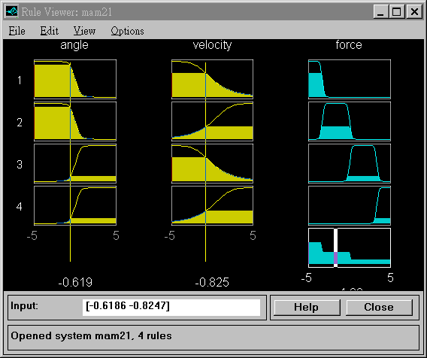
Fuzzy Reasoning: MATLAB Demo
>> ruleview mam21

Slide 22
Other Variants
Some terminology:
  Degrees of compatibility (match)
  Firing strength
  Qualified (induced) MFs
  Overall output MF

